Slide 1
Making this resource work for you
Prior to teaching this lesson, please refer to the ‘Unit Overview and Planning Document’.
Further guidance on planning Science Mastery lessons can be found in the detailed planning guidance document.
Refer to the ‘notes’ section on each slide for useful information, including suggested expositions, pedagogical content knowledge, suggested questions, answers and more. Consider using presenter mode so you can see this guidance throughout the lesson.
The introduction slides can be adapted to suit your teaching style and the needs of your class.
Before the lesson, adapt the fix-it slide to address any misconceptions identified in the previous lesson’s exit ticket.
Choose from the suggested activities to suit your class. The intention is not that you complete all of these, but that you select those which ones are most appropriate for your students. It may be appropriate to further adapt activities for your students.
These lessons are designed to occupy approximately 1 hour. To adapt for a shorter or longer lesson duration we advise you to adapt the activity section accordingly.
Please consider using the final slide to send feedback about this lesson or examples of PowerPoints that you have adapted to our design team. Your feedback is used to improve Science Mastery for all of our teachers and students. We appreciate all suggestions and comments.
Thank you for reading!
The Science Mastery Team

Slide 2


Taking it Further: Titration Calculations
Answer the questions below.
State two possible units for concentration.
Define concentration.
State the equation that links amount of substance (number of moles), concentration and volume.
Calculate the relative formula mass of sodium hydroxide (NaOH).
Calculate the concentration when 0.25 mol of sodium hydroxide is dissolved to make 200 cm³ of solution.
g/dm³ or mol/dm³
The mass (or amount) of solute per given volume of solvent.
$$Concentration = \frac{number of moles}{volume}$$
23+16+1 = 40
$$Concentration = \frac{0.25}{0.2}=1.25 mol/dm 3$$
Notes:
Big idea: Reactions rearrange matter
Foundation: State the pH of an alkaline solution.
Stretch: Write a balanced symbol equation for the reaction between lithium carbonate and sulfuric acid.
Answers:
Foundation: Greater than 7.
Stretch: Li₂CO₃ + H₂SO₄ → Li₂SO₄ + H₂O + CO₂

Slide 3
Taking it Further: Titration Calculations
Do Now:
State two possible units for concentration.
Define concentration.
State the equation that links amount of substance (number of moles), concentration and volume.
Calculate the relative formula mass of sodium hydroxide (NaOH).
Calculate the concentration when 0.25 mol of sodium hydroxide is dissolved to make 200 cm³ of solution.
Drill:
State the unit for amount of substance.
State the unit for volume.
Convert 50 cm3 to dm3.
Notes:
Drill answers:
mol
dm³
0.05 dm³

Slide 4
Taking it Further: Titration Calculations
Read Now:
Titrations are used to determine the concentration of reactant, based on the known concentration of another reactant. However, these titrations rely on colour changes being seen from the action of an indicator, such as phenolphthalein. But what happens for scientists that are colour-blind or visually impaired? Scientists at the Indian Institute of Science Education and Research in Kolkata have designed a smartphone app that can be used as a multi-sensory tool for detecting the end point of a titration. The app uses the phone’s camera to identify the end point of the titration, notifying the investigator that the titration is complete.
Describe the function of a titration.
Explain what is meant by the end point of a titration.
Explain the function of an indicator in a titration.
Briefly describe how this app could be useful to visually impaired scientists.

Slide 5
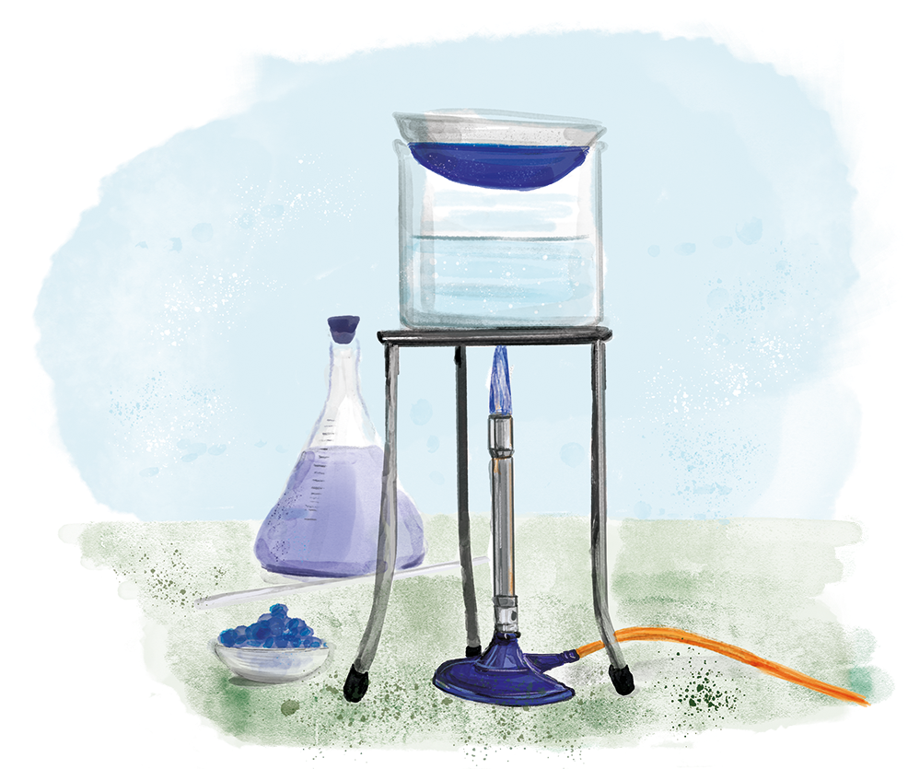
C4.3.13
03/02/2025
Taking it Further: Titration Calculations
C4.3.1 Prior Knowledge Review
C4.3.2 (HT) Introducing the Mole
C4.3.3 (HT) Mole Calculations
C4.3.4 PKR: Concentration
C4.3.5 TIF: Calculating Concentration
C4.3.6 TIF: Calculating an Unknown Concentration
C4.3.7 (HT) Amounts of Substances in Equations
C4.3.8 (HT) Limiting Reactants
C4.3.9 PKR: Reactions of Acids
C4.3.10 Acids, Alkalis and Neutralisation
C4.3.11 TIF: Acid-Alkali Titration
C4.3.12 TIF: Acid-Alkali Titration Analysis
C4.3.13 TIF: Titration Calculations
C4.3.14 (HT) Strong and Weak Acids
C4.3.15 TIF: Volumes of Gases
Notes:
Big idea: Reactions rearrange matter
In this lesson, students will review the function of a titration and the method before applying their knowledge of moles and concentration to calculating unknown concentrations from titration results.
Suggested Hook:
What is the function of a titration? How could they be useful to us in everyday life?

Slide 6

Following this lesson, students will be able to:
Explain the purpose of a titration
Use the equation that links concentration, volume and amount of substance
Use mole ratios to calculate an unknown concentration
Key Words:
acid
alkali
titration
neutralisation
titre
concordant
concentration
moles
Notes:
Guidance:
See unit overview document and planning guidance to see how these objectives are typically assessed at GCSE, including examples of what students should be able to do following this lesson.
Planning for different needs:
The learning objectives given on this slide are suggested based on the most common requirements for exams, however they can be adapted based on the needs of different classes.
For best practice, the unit preparation booklet should be used to determine the appropriate focus of lessons within the unit.
While it is not possible to explicitly split content into levelled grades, we recommend that lesson objectives can be classified as critical, core or stretch.
Critical: the content or skill is essential for all students to be able to progress.
Core: the content or skill is important for students to progress, but other opportunities may be available to revisit it.
Stretch: the content or skill may not be essential for all students but is important for students aiming for the highest grades.
Key skill: this is a crucial skill being developed in this unit as part of the skill mapping
C4.3.13 Lesson Objectives:
Critical: Explain the purpose of a titration
Critical: Use the equation that links concentration, volume and amount of substance
Core: Use mole ratios to calculate an unknown concentration

Slide 7
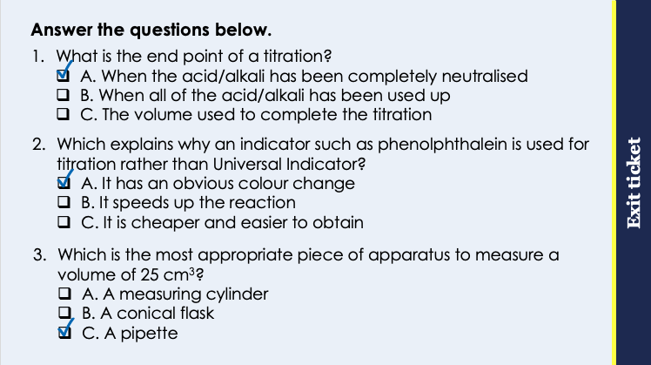
This is the fix-it portion of the lesson
The fix-it is an opportunity to respond to gaps in knowledge, especially those identified by the pre-unit quiz.
The teacher should customise this slide as needed, to facilitate
reteach, explanation, demonstration or modelling of ideas and concepts that students have not yet grasped or have misunderstood.
practise answering specific questions or of key skills.
redrafting or improving previous work.
Notes:
Purpose: to spend time on any gaps identified in previous learning from exit ticket.
Fix-it guidance from previous exit ticket:
Q1. Answer: A
If students answer B, this is a common misconception that ’all the acid or alkali has been used up’, which is a confusion about the volume of one reactant running out. If students answer C, they have confused the end point with the titre. To fix it, review the meaning of the end point of a titration.
Q2. Answer: A
If students answer B or C, they have not recognised the function of the indicator. Answering C shows that students have chosen a generic ‘advantage’. To fix it, you may wish to demo quickly a titration using universal indicator, showing how subjective the end point would be and explain why phenolphthalein would be used rather than Universal indicator.
Q3. Answer: C
If students answer A or B, they have not linked the precision of measurements to the resolution of equipment. To fix it, review the meaning of precise measurements and model for students how different measurements would result from using less precise instruments.

Slide 8
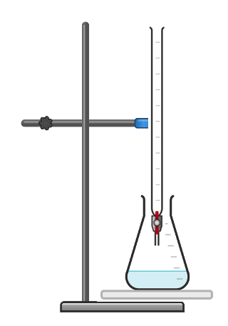
Titration
We know the volume and concentration of one reactant, which is in the conical flask.
We can calculate the number of moles of this reactant that reacted.
We can use the balanced chemical equation to determine the number of moles of the other reactant that reacted.
We can then calculate this unknown concentration using the number of moles that reacted and the volume of it that was required.
Notes:
Suggested exposition:
So we know the function of a titration is to determine an unknown concentration, using the neutralisation reaction between an acid and an alkali. Based on the balanced chemical equation, we can use a known concentration of a known volume of one reactant to determine the number of moles that reacted. We can then use the balanced equation to show how many moles of the other reactant reacted. We can then use the volume that neutralises this reactant to determine its concentration.

Slide 9
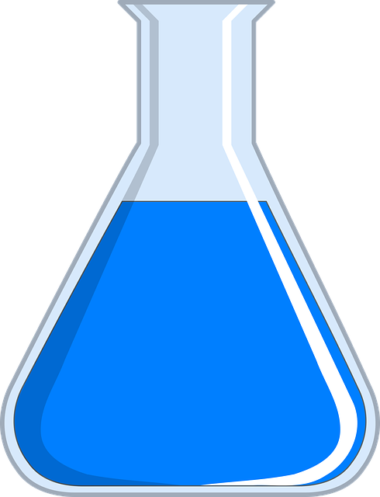
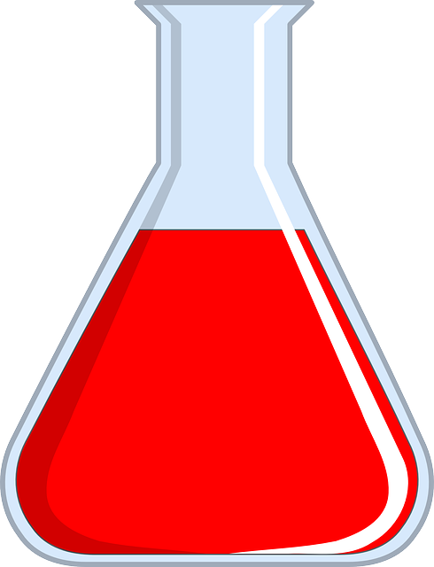
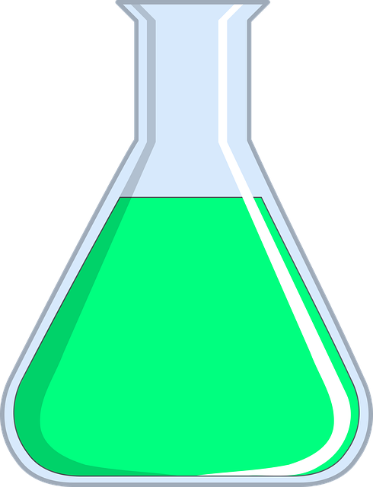
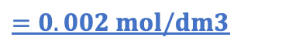



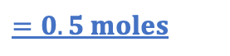
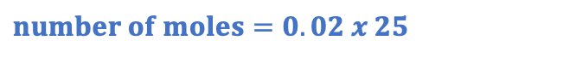
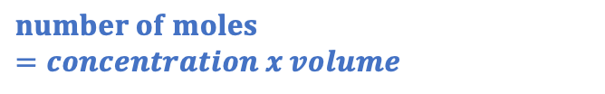
Calculating an Unknown Concentration
Higher Tier only
Sodium hydroxide + sulfuric acid → sodium sulfate + water
2NaOH + H₂SO₄ → Na₂SO₄ + 2H₂O
Volume = 25 dm³
Volume = 15 dm³
Concentration = 0.02 mol/dm³
Concentration = ?
$$Concentration= \frac{number of moles}{volume}$$
The molar ratio of alkali : acid is 2 : 1, or 0.5 : 0.025
$$Concentration= \frac{number of moles}{volume}$$
$$number of moles=concentration x volume$$
$$Concentration= \frac{0.025}{15}$$
$$number of moles=0.02 x 25$$
$$=0.002 mol/dm3$$
$$=0.5 moles$$
Notes:
Suggested exposition:
Let’s have a quick review of how we can use a balanced chemical equation quantitatively.
In a neutralisation reaction, if we know
the balanced chemical equation for the reaction
the concentration and volume of one reactant
the volume of the other reactant
…we can calculate the concentration of the other reactant!
Let’s take this example of a neutralisation reaction. We can see that the molar ratio of alkali: acid (alkali to acid) is 2:1. So however many moles of alkali reacts, half of that number of moles of acid will react.
We are given some information about both the alkali and the acid.
For the alkali, I can see that 25 dm³ is the volume of alkali that reacted.
This alkali has a concentration of 2 mol/dm³.
So, I know both the volume and concentration of the alkali. What does that allow me to calculate? The number of moles.
Number of moles can be calculated by multiplying concentration by volume. If we do this calculation we can see that 0.5 moles of alkali reacted.
Now let’s go back to the molar ratio.
As we said before, we can see that the molar ratio of alkali: acid (alkali to acid) is 2:1.
So if we have 0.5 moles of alkali, we must have half of that number of moles of acid – that’s 0.025 moles.
Now looking at the acid, we know we have 0.025 moles of acid. And we know that we have a volume of 15 dm³. We need to find out the concentration of the acid. What formula can we use? Concentration = number of moles divided by volume.
So, let’s plug those numbers into the formula. We can see that the concentration of the acid is 0.002 mol/dm³.
So let’s recap what we did here.
We had an acid and alkali reacting in a neutralisation reaction.
We knew the volume and the concentration of one of these, which allowed us to calculate the number of moles of that reactant.
Knowing the number of moles of one reactant let’s us calculate the number of moles of the other reactant, because we know the molar ratio.
That then gives us enough information to calculate the concentration of the second reactant, because we now know the number of moles and the volume.
Let’s use our own measured values now to determine our unknown concentration.

Slide 10

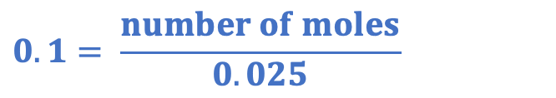
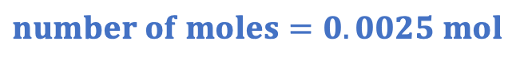
Calculate your unknown concentration
Sodium hydroxide + sulfuric acid → sodium sulfate + water
2NaOH + H₂SO₄ → Na₂SO₄ + 2H₂O
2 : 1
We used 25 cm³ of 0.1 mol/dm³ sodium hydroxide solution.
What is the mole ratio?
2 : 1
How many moles of sulfuric acid reacted?
$$Concentration= \frac{number of moles}{volume}$$
0.00125 mol
$$0.1= \frac{number of moles}{0.025}$$
$$number of moles=0.0025 mol$$
Notes:
Suggested exposition:
Let’s now use our own results to determine the concentration of the sulfuric acid we used.
We used 25 cm3 of 0.1 mol/dm3 soidum hydroxide solution.
What can we calculate from this?
The number of moles of sodium hydroxide that reacted.
Animate working. Remember that we need to convert any volumes in cm3 to dm3, as our concentration is given in mol/dm3.
So we can see that 0.0025 moles of sodium hydroxide reacted.
What is the mole ratio between sodium hydroxide and sulfuric acid?
2:1
This means that if 0.0025 mol of sodium hydroxide reacted, how much sulfuric acid reacted?
0.00125 mol.

Slide 11
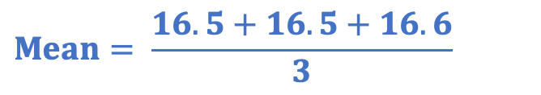




Calculate your unknown concentration
Sodium hydroxide + sulfuric acid → sodium sulfate + water
2NaOH + H₂SO₄ → Na₂SO₄ + 2H₂O
Titration | Volume of acid used (cm³)
1 | 18.7
2 | 16.5
3 | 16.5
4 | 16.6
5 | 16.9
How many moles of sulfuric acid reacted?
What is the concentration of acid used?
0.00125 mol
$$Concentration= \frac{number of moles}{volume}$$
Which of these results are concordant?
$$Concentration = \frac{0.00125}{0.01653}$$
$$Concentration=0.076 mol/dm3$$
What is the mean volume of acid used?
$$Mean= \frac{16.5+16.5+16.6}{3}$$
$$Mean=16.53 cm3$$
Notes:
Suggested exposition:
So we’ve now calculated that 0.00125 mol of sulfuric acid reacted.
How can we calculate the concentration of sulfuric acid?
We can use concentration = number of moles/volume
But what volume do we use?
When doing a titration, the first volume is often not as accurate as later trials because the experimenter is not sure when to expect the end point. But once they know when the end point will be roughly, it is much easier for them to expect it, and therefore collect more accurate results, in subsequent titrations.
As with any measurements in science, we should repeat our experiments and then take an average of our results.
When doing this for titrations, we only use the concordant results. These are results that fall between 0.2 cm3 of each other, meaning that we discount any anomalous results. We then take the mean just from these concordant results.
Which of these results are concordant?
16.5, 16.5 and 16.6. We do not use 18.7 or 16.9 because they are not concordant.
What is the mean volume of acid used?
Mean = (16.5+16.5+16.6)/3
We can then use this as our volume and divide our number of moles by the volume to determine the concentration of the acid, remembering to convert the volume into dm3!

Slide 12

Is this correct?
The reactant in a titration with the unknown concentration always has to be the alkali.
Notes:
This is a common misconception where students assume that the unknown is always the alkali. It is important to use mixed calculation and scenario questions.
Suggested guidance:
Talk tasks can be used in a variety of ways to suit the particular needs of the students you are teaching. Through exchanging views with others, students develop their understanding of the science beyond what could be achieved individually.
Science classrooms that successfully integrate talk have the following features:
Science talk is a regular feature of lessons and is woven into classroom activities.
Students are paired or grouped strategically by the teacher to ensure productive interaction. This might take into consideration the students’ proficiency of the English language, how encouraging they might be to peers and their attainment in the topic. It’s a good idea to consider these pairings in the class seating plan.
Students are encouraged and supported to talk, but are not forced to talk.
The teacher should take on the role of a facilitator, engaging with conversations where necessary and encouraging or steering the conversation where needed.
Students are encouraged to use the language they have to express their ideas (e.g., everyday language, imperfect English, native language), but also to incorporate science specific terminology where this is more accurate or has been taught.
6. Scientifically inaccurate ideas are not dismissed by the partner or teacher; open discussion and further investigation are relied on to help students construct ideas that support them to progress in their scientific understanding.
7. Guidelines for behaviour during talk tasks are explicit and frequently reviewed. Rules for students might be:
Listen carefully to your partner
Take turns talking.
Speak one at a time, without interrupting.
Politely agree or disagree and explain why.
Politely point out if your partner has used a scientific word incorrectly, if they have explained the science incorrectly, or if there is a more accurate way to describe something.
If confused, ask questions.
Stay focused on the discussion topic.
Respond to one another.

Slide 13
Which values should we use?
A student performs a titration 5 times.
They obtain these results for the volume of alkali needed to neutralise a known volume and concentration of acid.
Titration | Volume of alkali used (cm³)
1 | 24.2
2 | 21.80
3 | 21.75
4 | 21.80
5 | 21.75
The student want to use the values to determine the concentration of the alkali.
What values should they use?
Why?
How should they use these results?
What is the name for these results?
What do these results fall within?
Notes:
Suggested points:
The student should only use the concordant results, which are results that fall within 0.2 cm3 of each other (sometimes this value is explicitly stated in exams as 0.1 cm3, but if this value is to be used, it will be stated).
The first result is often a rough value because the experimenter is not sure when to start watching closely for the end point. This should not be used if it is not concordant, because it will decrease the accuracy of the results (further from the true value). The concordant results should be used to calculate a mean.
Suggested guidance:
Talk tasks can be used in a variety of ways to suit the particular needs of the students you are teaching. Through exchanging views with others, students develop their understanding of the science beyond what could be achieved individually.
Science classrooms that successfully integrate talk have the following features:
Science talk is a regular feature of lessons and is woven into classroom activities.
Students are paired or grouped strategically by the teacher to ensure productive interaction. This might take into consideration the students’ proficiency of the English language, how encouraging they might be to peers and their attainment in the topic. It’s a good idea to consider these pairings in the class seating plan.
Students are encouraged and supported to talk, but are not forced to talk.
The teacher should take on the role of a facilitator, engaging with conversations where necessary and encouraging or steering the conversation where needed.
Students are encouraged to use the language they have to express their ideas (e.g., everyday language, imperfect English, native language), but also to incorporate science specific terminology where this is more accurate or has been taught.
6. Scientifically inaccurate ideas are not dismissed by the partner or teacher; open discussion and further investigation are relied on to help students construct ideas that support them to progress in their scientific understanding.
7. Guidelines for behaviour during talk tasks are explicit and frequently reviewed. Rules for students might be:
Listen carefully to your partner
Take turns talking.
Speak one at a time, without interrupting.
Politely agree or disagree and explain why.
Politely point out if your partner has used a scientific word incorrectly, if they have explained the science incorrectly, or if there is a more accurate way to describe something.
If confused, ask questions.
Stay focused on the discussion topic.
Respond to one another.

Slide 14


True or false?
Volume can be measured in cm³
Number of moles is measured in mol
Concentration is measured in dm³
Concordant results fall within 0.5 cm³ of each other.
True
True
False
False
Notes:
Purpose: to check that key knowledge from the introduce phase has been learnt and understood.
You may wish to provide students with white boards to enable them to carry out calculations.
1T; 2T; 3F; 4F

Slide 15
Drill
Describe the function of a titration.
Give the name for the volume of liquid that is measured using a titration.
Define concordant results.
State the equation that links concentration, number of moles and volume.
State the unit for concentration.
State the unit for number of moles.
State the unit for volume that should be used in calculations.
Convert 25 cm³ to dm³.
Notes:
Purpose: This is a knowledge drill. The purpose of this is to check that the critical knowledge is secure before pupils move onto independent practice.
Suggested guidance: There are a range of ways this could be done depending on time and ability range of the class:
Mini whiteboards
As full sentences in exercise books
As short answers in exercise books
In the pupil workbook
As pair talk
As cold call

Slide 16
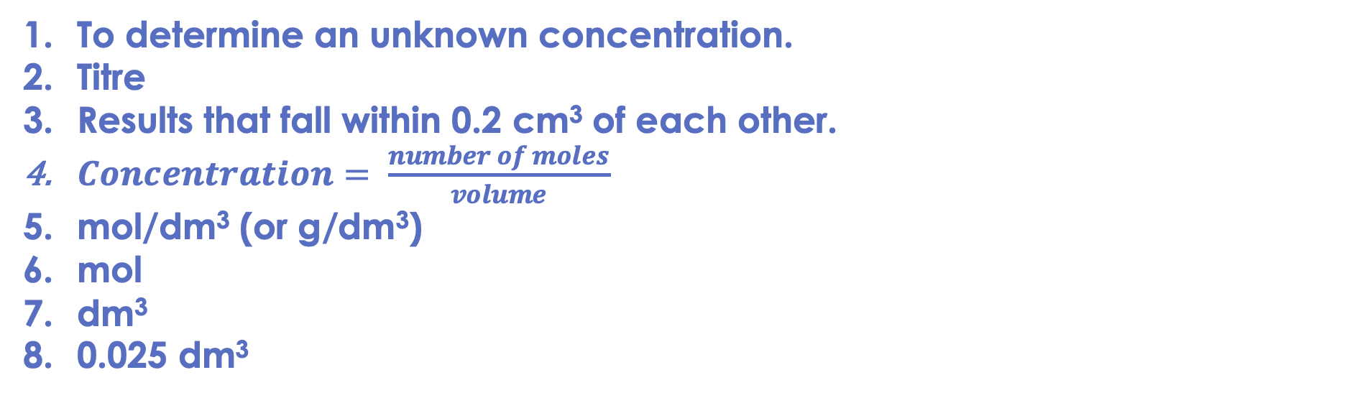
Drill answers
To determine an unknown concentration.
Titre
Results that fall within 0.2 cm³ of each other.
$Concentration= \frac{number of moles}{volume}$
mol/dm³ (or g/dm³)
mol
dm³
0.025 dm³
Notes:
Purpose: This is a knowledge drill. The purpose of this is to check that the critical knowledge is secure before pupils move onto independent practice.
Suggested guidance: There are a range of ways this could be done depending on time and ability range of the class:
Mini whiteboards
As full sentences in exercise books
As short answers in exercise books
In the pupil workbook
As pair talk
As cold call

Slide 17

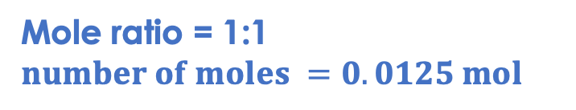
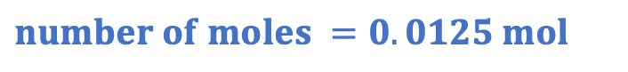
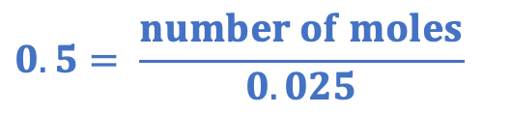



I: calculating an unknown concentration
Titration | Volume of alkali used (cm³)
1 | 27.20
2 | 26.40
3 | 26.45
4 | 26.10
5 | 26.50
A student uses a titration to determine the concentration of lithium hydroxide.
They use 25 cm³ of 0.5 mol/dm³ hydrochloric acid.
They repeated the titration 5 times, and their results for the volume of alkali needed to neutralise the acid are shown in the table.
The equation for the reaction is:
LiOH + HCl → LiCl + H₂O
Which values from the table should be used?
The concordant results, which are within 0.1 cm³ of each other (26.40, 26.45, 26.50).
What is the mean volume of alkali used?
How many moles of alkali reacted?
$Mean = \frac{26.40+26.45+26.50}{3}$ = 26.45 cm³
Mole ratio = 1:1
$$number of moles =0.0125 mol$$
How many moles of acid reacted?
$$concentration= \frac{number of moles}{volume}$$
What is the concentration of alkali?
$$concentration= \frac{number of moles}{volume}$$
$$0.5= \frac{number of moles}{0.025}$$
$$concentration= \frac{0.0125}{0.02645}$$
$$number of moles =0.0125 mol$$
$concentration=0.47 mol$/dm³
Notes:
Purpose: The I-We-You section aims to support pupils to build skills that they most commonly need when answering questions associated with this knowledge in the assessment. This section is also used to interleave other content we expect pupils to know at this stage of their education in order that they build a big picture of the science they are learning.
For the ‘I’ activity, the teacher should model how to answer the question. They can do this by narrating their thinking process aloud, and making links to learning earlier in the lesson explicit.
For the ‘we’ activity, the teacher and students work though a similar example together, in order to prepare students to be able to answer a similar question independently.
Opportunities for the ‘you’ activity – independent practise – occur in the activity portion of the lesson once the student is secure enough to process independently.

Slide 18



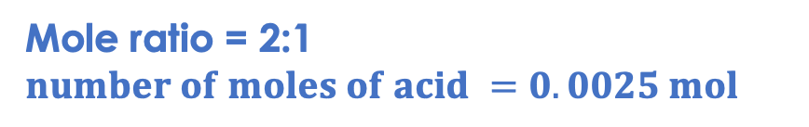
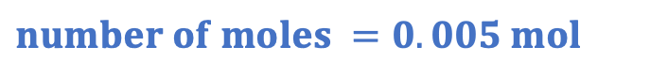
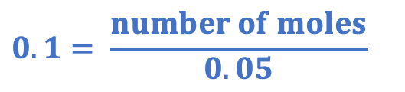

We: calculating an unknown concentration
A student uses a titration to determine the concentration of a sulfuric acid sample.
They use 50 cm³ of 0.1 mol/dm³ sodium hydroxide solution.
They required 34.5 cm³ of sulfuric acid to neutralise the sodium hydroxide.
The equation for the reaction is:
2 NaOH + H₂SO₄ → Na₂SO₄ + 2 H₂O
How many moles of alkali reacted?
How many moles of acid reacted?
$$concentration= \frac{number of moles}{volume}$$
Mole ratio = 2:1
$$number of moles of acid =0.0025 mol$$
$$0.1= \frac{number of moles}{0.05}$$
What is the concentration of the acid?
$$number of moles =0.005 mol$$
$$concentration= \frac{number of moles}{volume}$$
$$concentration= \frac{0.0025}{0.0345}$$
$concentration=0.072 mol$/dm³
Notes:
Purpose: The I-We-You section aims to support pupils to build skills that they most commonly need when answering questions associated with this knowledge in the assessment. This section is also used to interleave other content we expect pupils to know at this stage of their education in order that they build a big picture of the science they are learning.
For the ‘I’ activity, the teacher should model how to answer the question. They can do this by narrating their thinking process aloud, and making links to learning earlier in the lesson explicit.
For the ‘we’ activity, the teacher and students work though a similar example together, in order to prepare students to be able to answer a similar question independently.
Opportunities for the ‘you’ activity – independent practise – occur in the activity portion of the lesson once the student is secure enough to process independently.

Slide 19


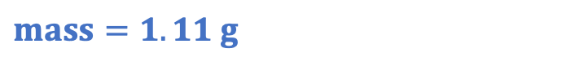
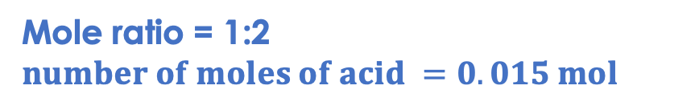
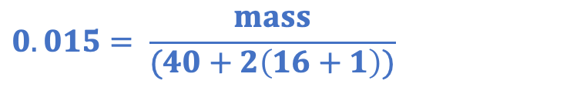
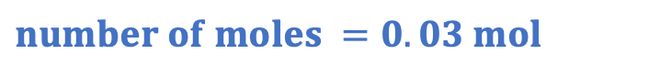
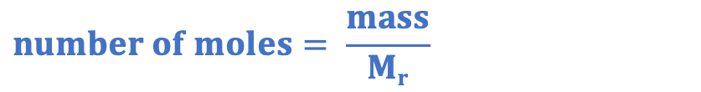
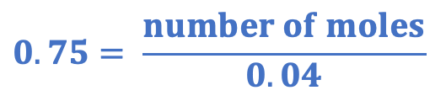

You: calculating an unknown concentration
A student uses a titration to determine the concentration of calcium hydroxide.
They use 40 cm³ of 0.75 mol/dm³ nitric acid solution.
They required 19.5 cm³ of calcium hydroxide to neutralise the nitric acid.
The equation for the reaction is:
Ca(OH)₂ + 2 HNO₃ → Ca(NO₃)₂ + 2 H₂O
How many moles of acid reacted?
What is the concentration of the alkali?
$$concentration= \frac{number of moles}{volume}$$
$$concentration= \frac{number of moles}{volume}$$
$$concentration= \frac{0.015}{0.0195}$$
$$0.75= \frac{number of moles}{0.04}$$
$concentration=0.769 mol$/dm³
$$number of moles =0.03 mol$$
What mass of alkali was dissolved in the given volume of solution?
How many moles of alkali reacted?
Mole ratio = 1:2
$$number of moles of acid =0.015 mol$$
$$number of moles= \frac{mass}{Mr}$$
$$0.015= \frac{mass}{(40+2\left(16+1\right))}$$
$$mass=1.11 g$$
Notes:
Purpose: The I-We-You section aims to support pupils to build skills that they most commonly need when answering questions associated with this knowledge in the assessment. This section is also used to interleave other content we expect pupils to know at this stage of their education in order that they build a big picture of the science they are learning.
For the ‘I’ activity, the teacher should model how to answer the question. They can do this by narrating their thinking process aloud, and making links to learning earlier in the lesson explicit.
For the ‘we’ activity, the teacher and students work though a similar example together, in order to prepare students to be able to answer a similar question independently.
Opportunities for the ‘you’ activity – independent practise – occur in the activity portion of the lesson once the student is secure enough to process independently.

Slide 20
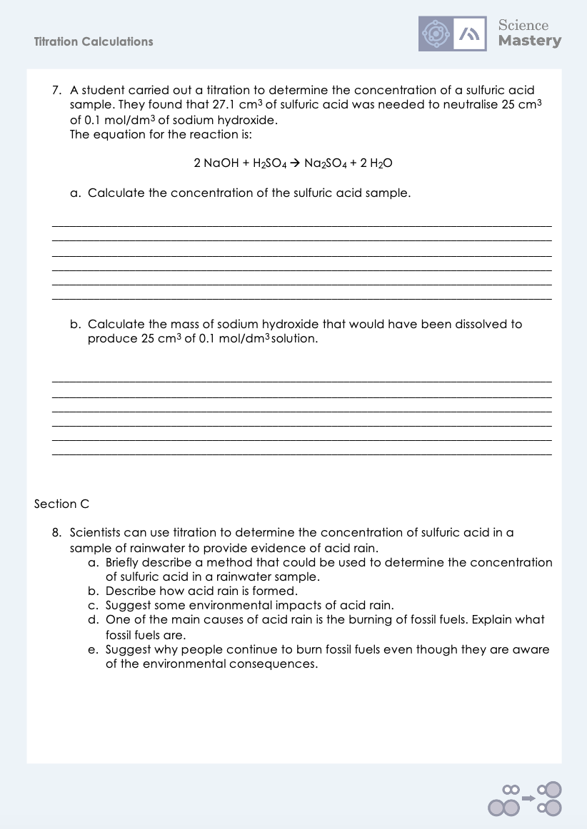
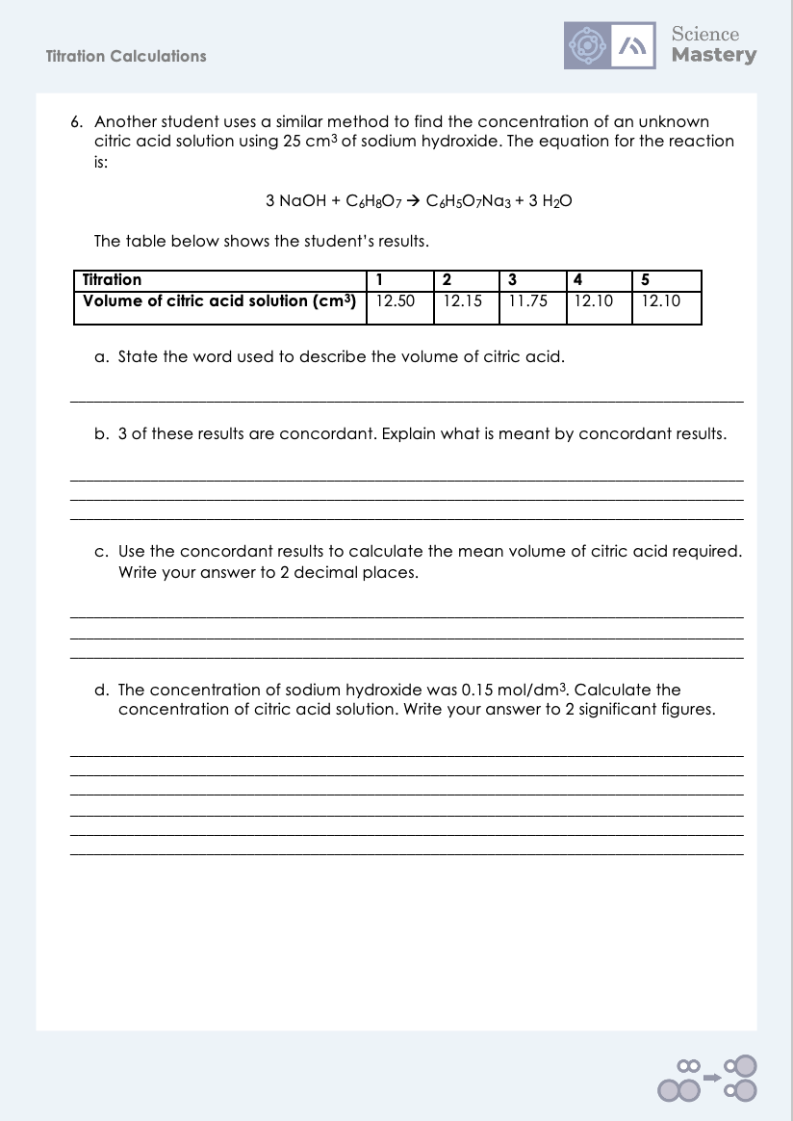
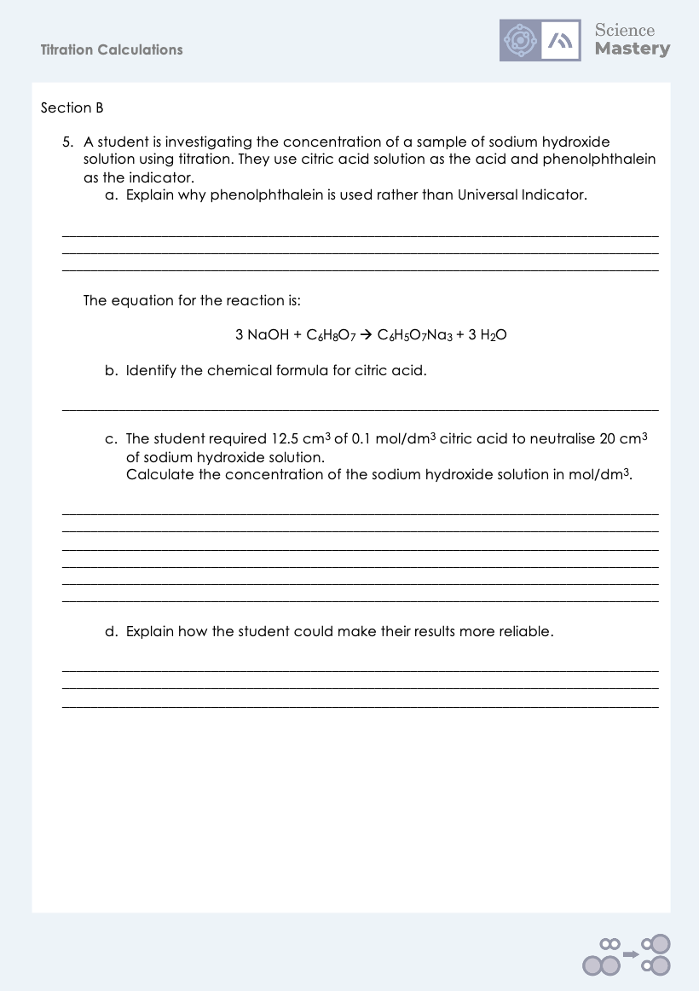
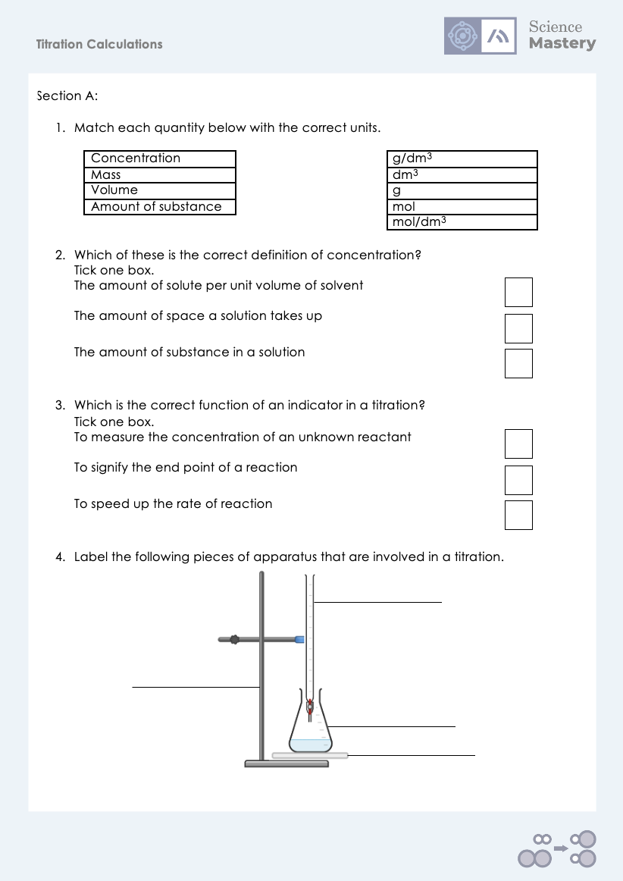
Activity

Slide 21
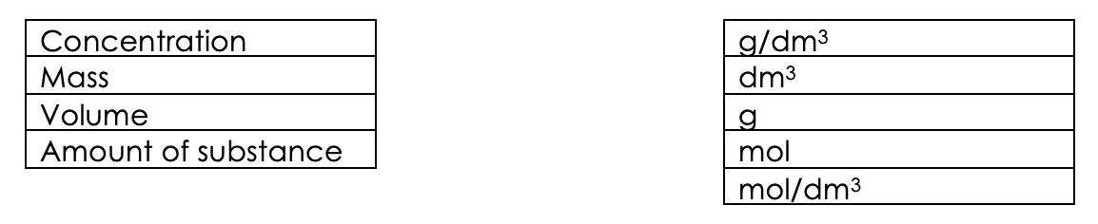
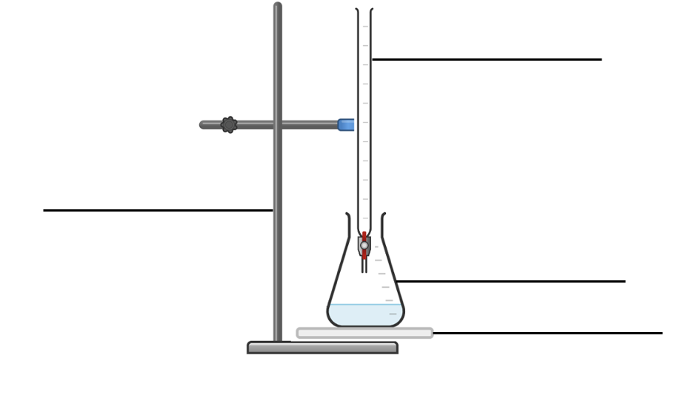
Answers
1.
2. The amount of solute per unit volume of solvent.
3. To signify the end point of the reaction.
burette
clamp stand
conical flask
white tile

Slide 22
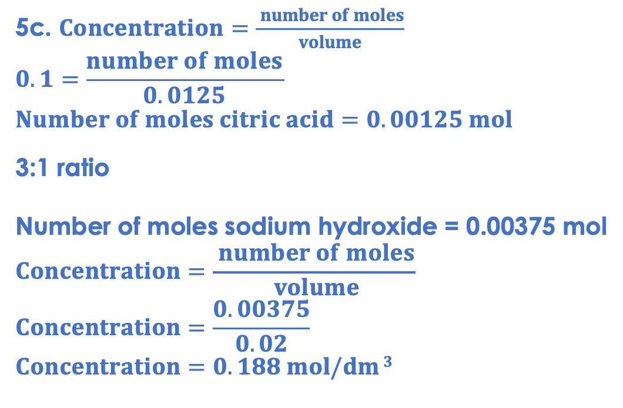
Answers
5a. It changes colour to clear in a neutral solution, which is a definitive end point. Universal indicator would not show such a clear colour change.
5b. C₆H₈O₇
5d. Repeat the experiment to make sure results are concordant.
Take a mean of the concordant results.
5c. $Concentration=\frac{ number of moles}{volume}$
$$0.1=\frac{number of moles}{0.0125}$$
$$Number of moles citric acid=0.00125 mol$$
3:1 ratio
Number of moles sodium hydroxide = 0.00375 mol
$$Concentration=\frac{ number of moles}{ volume}$$
$$Concentration=\frac{0.00375}{0.02}$$
$$Concentration=0.188 mol/dm 3$$

Slide 23
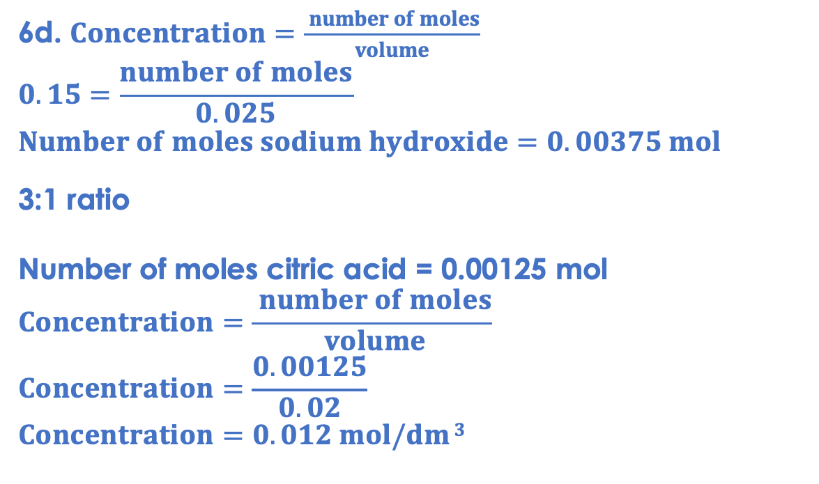
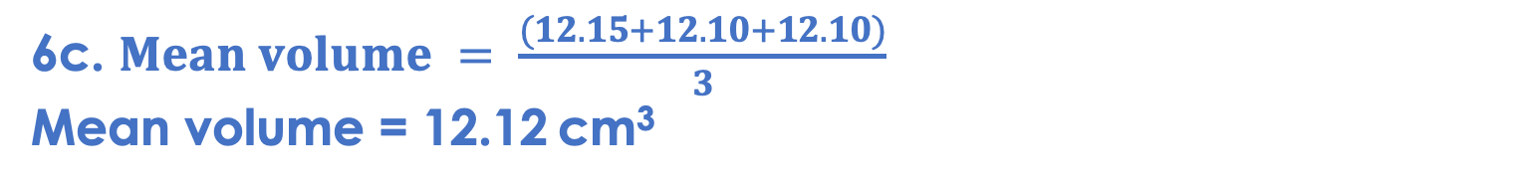
Answers
6a.Titre
6b.Results that are within 0.1 cm³ or (0.2 cm³) of each other.
6c. $Mean volume = \frac{(12.15+12.10+12.10)}{3}$
Mean volume = 12.12 cm³
6d. $Concentration=\frac{ number of moles}{volume}$
$$0.15=\frac{number of moles}{0.025}$$
$$Number of moles sodium hydroxide=0.00375 mol$$
3:1 ratio
Number of moles citric acid = 0.00125 mol
$$Concentration=\frac{ number of moles}{ volume}$$
$$Concentration=\frac{0.00125}{0.02}$$
$$Concentration=0.012 mol/dm 3$$

Slide 24
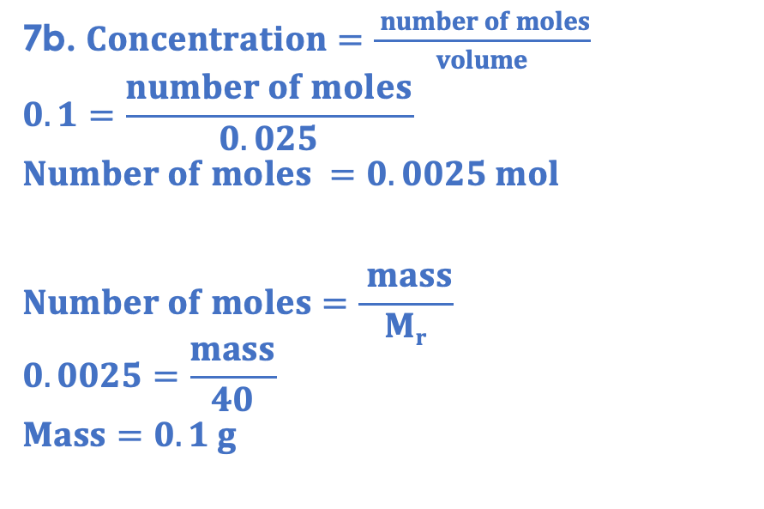
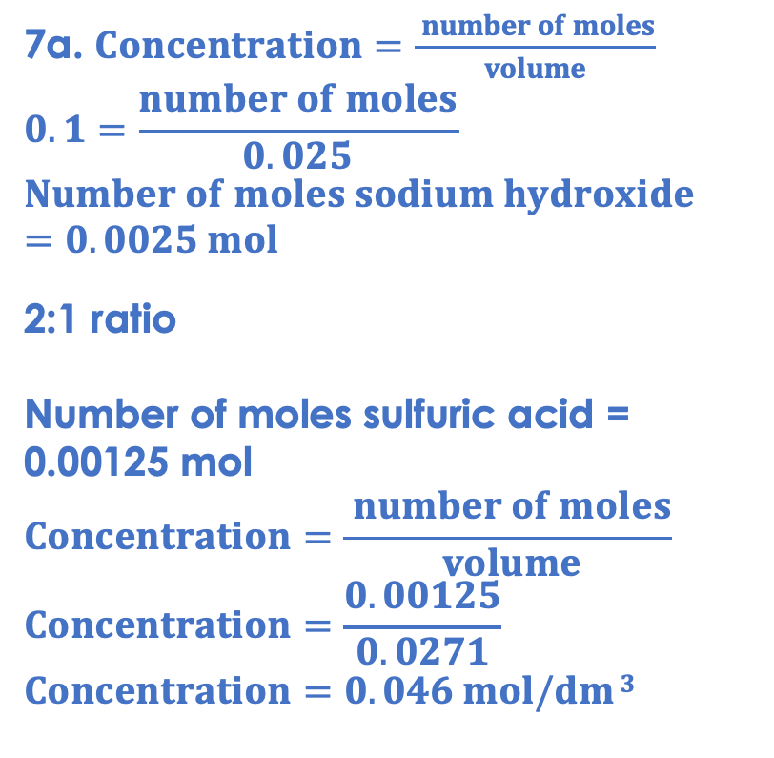
Answers
7a. $Concentration=\frac{ number of moles}{volume}$
$$0.1=\frac{number of moles}{0.025}$$
$$Number of moles sodium hydroxide=0.0025 mol$$
2:1 ratio
Number of moles sulfuric acid = 0.00125 mol
$$Concentration=\frac{ number of moles}{ volume}$$
$$Concentration=\frac{0.00125}{0.0271}$$
$$Concentration=0.046 mol/dm 3$$
7b. $Concentration=\frac{ number of moles}{volume}$
$$0.1=\frac{number of moles}{0.025}$$
$$Number of moles =0.0025 mol$$
$$Number of moles=\frac{ mass}{Mr}$$
$$0.0025=\frac{mass}{40}$$
$$Mass=0.1 g$$

Slide 25
Answers
8a.
Measure a known volume of a known concentration of an alkali
Add the alkali to a conical flask with an indicator
Slowly add the acid to the alkali
When the indicator changes colour, the alkali has been neutralized
The equation can be used to calculate the concentration of the unknown (the acid)
8b. When fossil fuels are burned, sulfur dioxide can be produced. This dissolved in clouds to form acid rain.
8c. Harmful to habitats, contaminating water supplies (and food chains), reacting with alkalis in building materials.
8d. Coal, oil and natural gas. They are formed from the decayed remains of plants and animals.
8e. Power stations/infrastructure already exist for burning fossil fuels, building infrastructure for renewable or nuclear resources can be a large expenditure of government budgets.

Slide 26
Answer the questions below.
What is the purpose of a titration?
A. To determine an unknown concentration
B. To determine how long it takes for an acid to react with an alkali
C. To produce a neutralisation reaction
✓
What is the function of an indicator in a titration?
A. To signify the end point of a titration
B. To speed up the titration
C. To show the concentration of a substance
✓
What is the concentration of 25 cm³ sodium hydroxide solution that neutralises 20 cm³ of 0.2 mol/dm³ hydrochloric acid solution?
The equation for the reaction is:
NaOH + HCl → NaCl + H₂O
A. 0.004 mol/dm³
B. 0.00001 mol/dm³
C. 0.16 mol/dm³
✓
Notes:
Q1. Answer: A
If students answer B or C, they are not clear on the function of a titration. To fix it, explain the purpose and give students some examples of where titrations may be useful in real life, such as determining concentration of acids in foods or concentration of pollutants in water samples.
Q2. Answer: A
If students answer B or C, they have not recognised function of the indicator. To fix it, review the function of the indicator and explain why phenolphthalein would be used rather than Universal indicator.
Q3. Answer: C
If students answer A, they have taken the number of moles of the hydrochloric acid and missed the final two steps. If students answer B, they have used the 1:1 mole ratio but have multiplied number of moles by volumes. To fix it, model how to lay out and solve this question and give students further practice.

Slide 27
Lesson C4.3.13
What was good about this lesson? | What can we do to improve this lesson?
Send us your feedback by clicking this link
or by emailing sciencemastery@arkonline.org
Thank you!

